Slide 1



Two-mode squeezing in Floquet engineered power-law interacting spin models
Arman Duha (arman.duha@okstate.edu)
Thomas Bilitewski (thomas.bilitewski@okstate.edu)
Dept. of Physics, Oklahoma State University
arXiv:2402.18642
1
06/06/2024, DAMOP Meeting Arman Duha Oklahoma State University

Slide 2
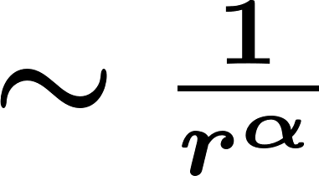
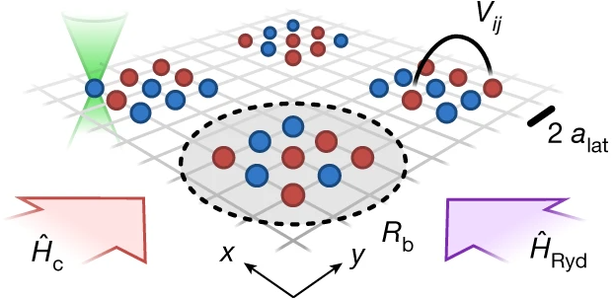
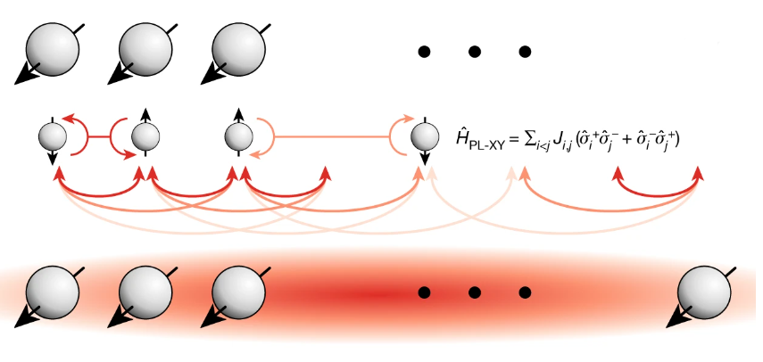
Power-law interacting spin systems
Rydberg array
Eckner, William J., et al., Nature 621.7980 (2023): 734-739
"Realizing spin squeezing with Rydberg interactions in an optical clock."
Trapped ions
Franke, Johannes, et al., Nature 621.7980 (2023): 740-745.
"Quantum-enhanced sensing on optical transitions through finite-range interactions."
2
06/06/2024, DAMOP Meeting Arman Duha Oklahoma State University

Slide 3
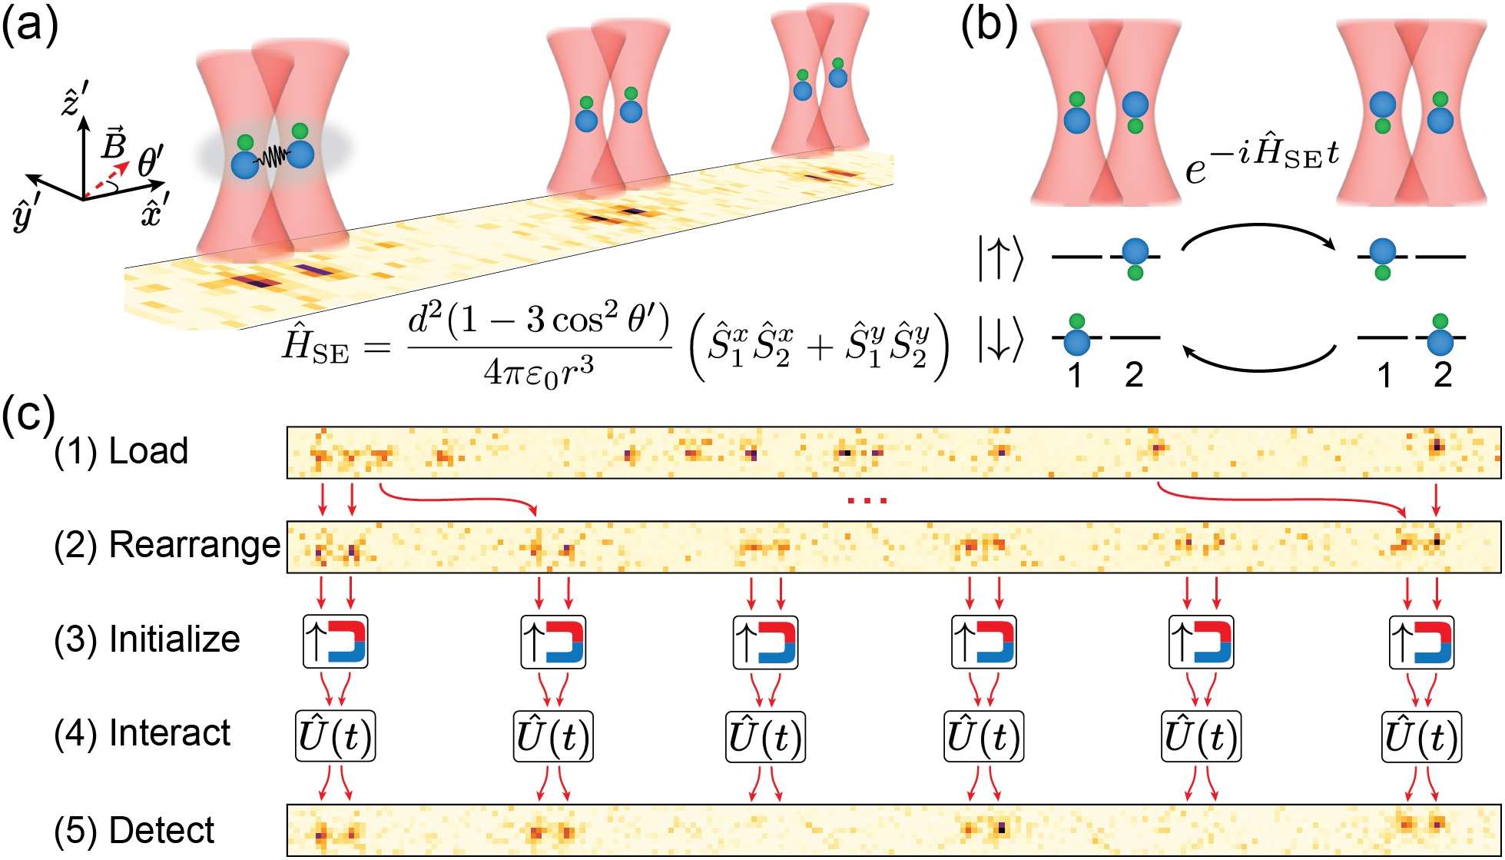
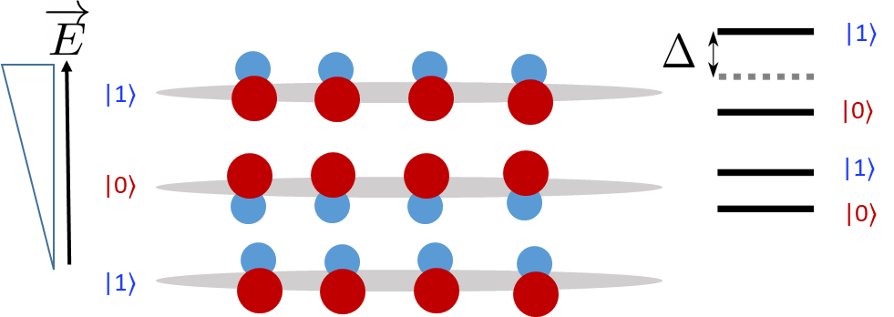
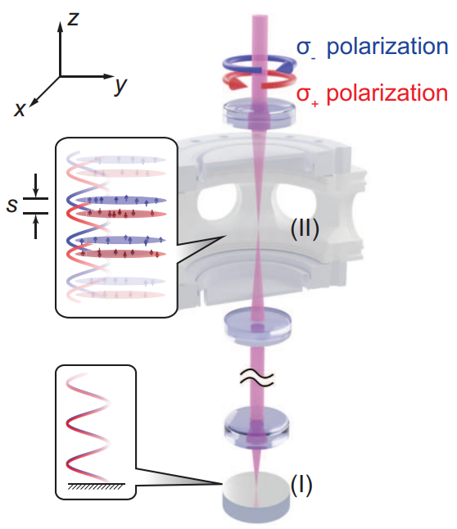
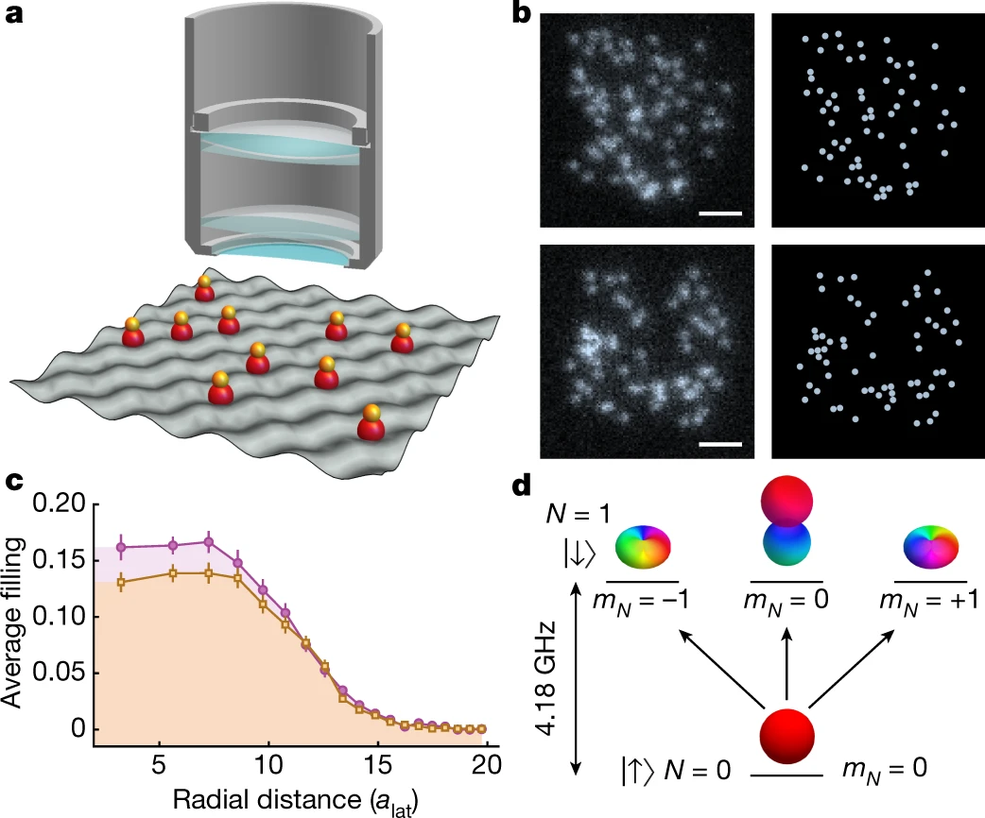


Spatial Control & Single-site Resolution
Polar Molecules
Tweezer Arrays
Ye et al., Science 375, 1299-130 (2022) “Reactions between layer-resolved molecules
mediated by dipolar spin exchange”
Cheuk et al., Science 382,1143-1147(2023)
“On-Demand Entanglement of Molecules in
a Reconfigurable Optical Tweezer Array”
Magnetic atoms
Quantum Gas Microscope
Bakr et al., Nature 614, 64–69 (2023) ”Probing site-resolved correlations in a
spin system of ultracold molecules”
Ketterle et al., arXiv:2302.07209 (2023) “Realization of a bilayer system of dipolar atoms”
3
06/06/2024, DAMOP Meeting Arman Duha Oklahoma State University

Slide 4
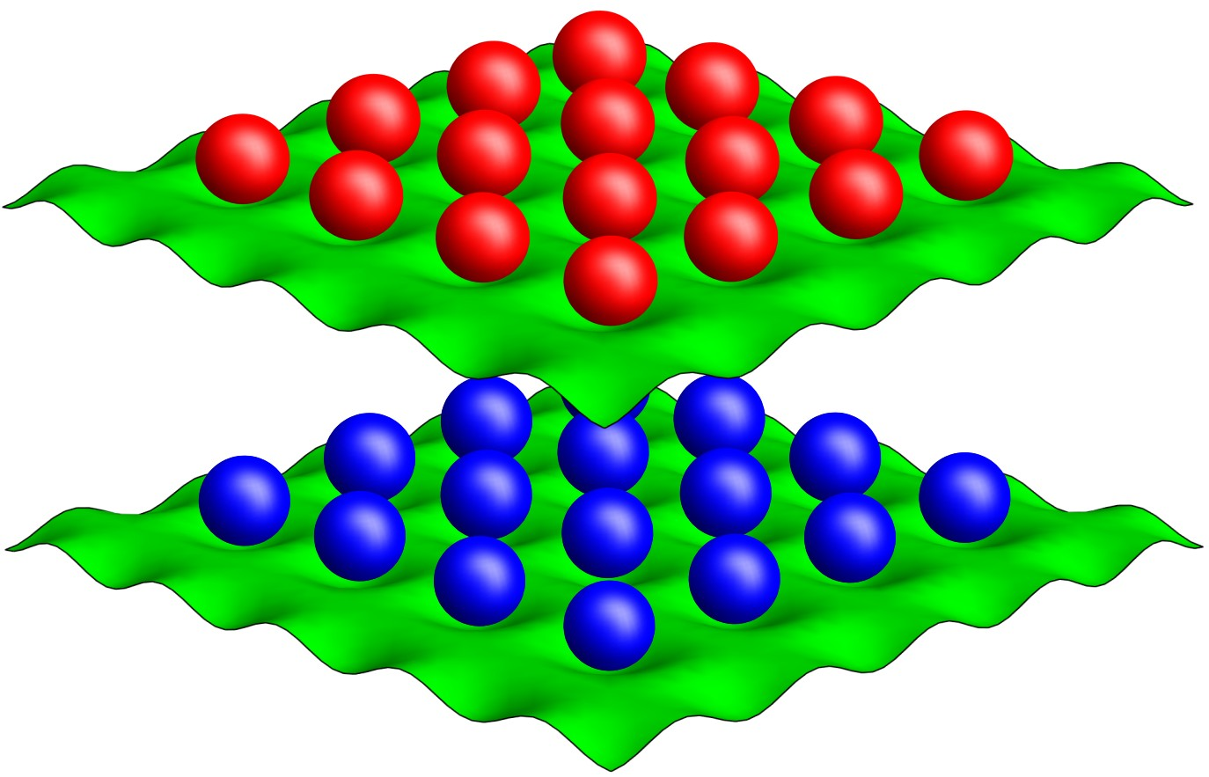

Bi-layer of Power-law interacting spin models
Current Capabilities:
Spatial Control
Temporal Control via local fields
Tunable Long-range interactions
Can we utilize this to enhance spin squeezing?
YES!
4
06/06/2024, DAMOP Meeting Arman Duha Oklahoma State University

Slide 5
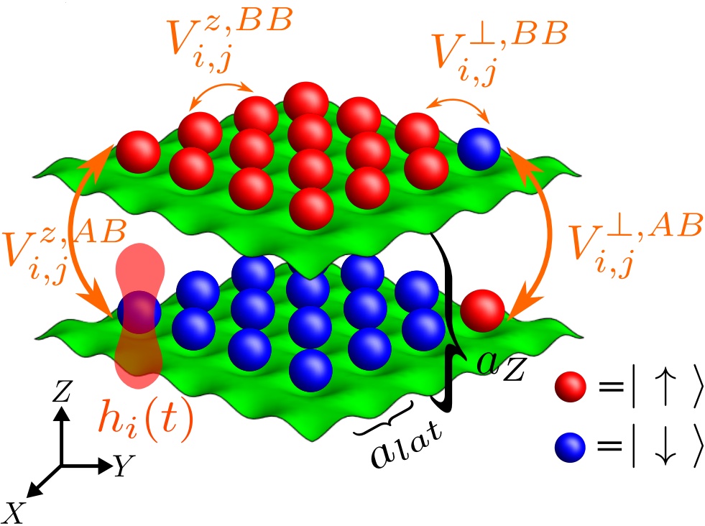
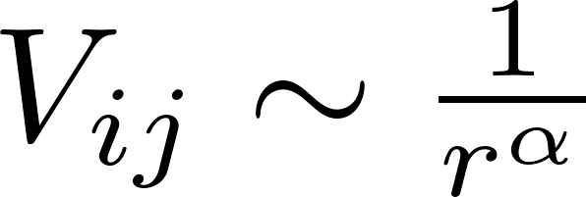
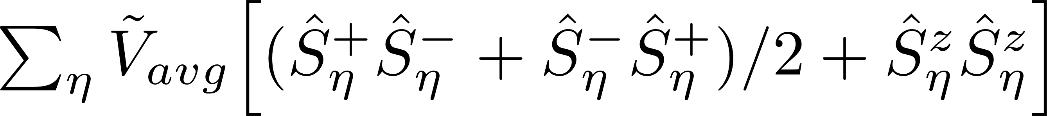
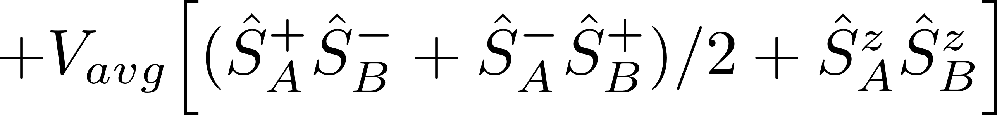
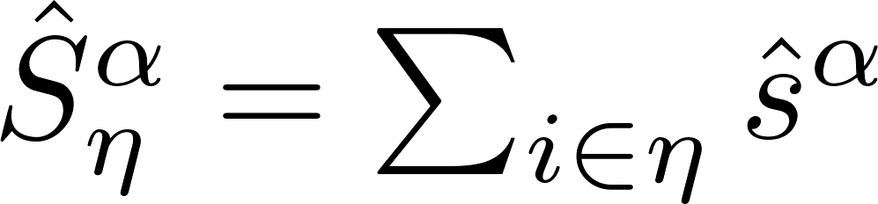
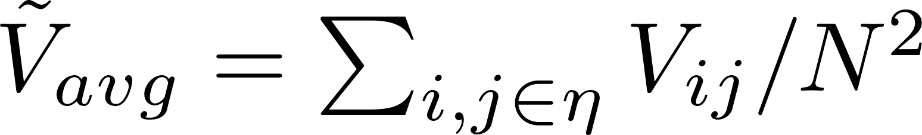
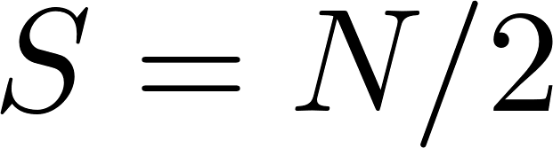
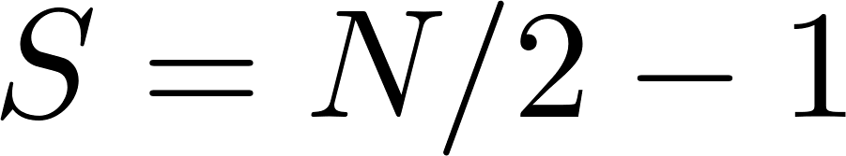
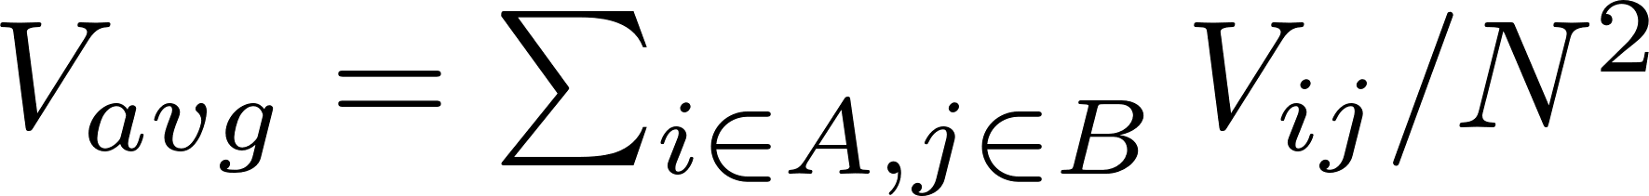
From power-law interaction to two-mode squeezing
Intralayer
Interlayer
Gap protection at Heisenberg point:
Gap protected
Collective state
Gap
5
06/06/2024, DAMOP Meeting Arman Duha Oklahoma State University

Slide 6
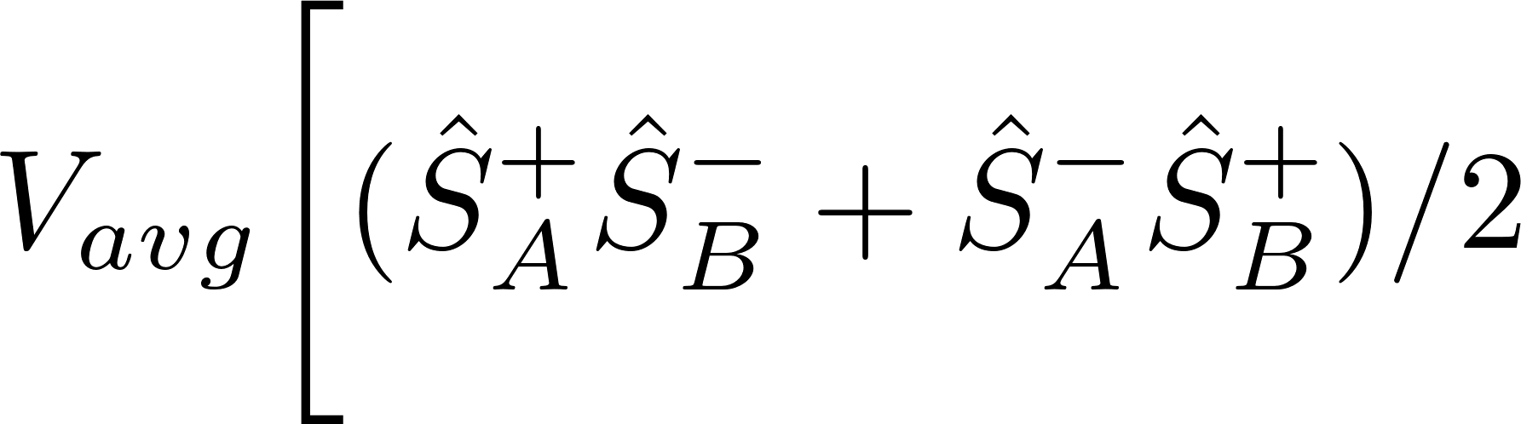
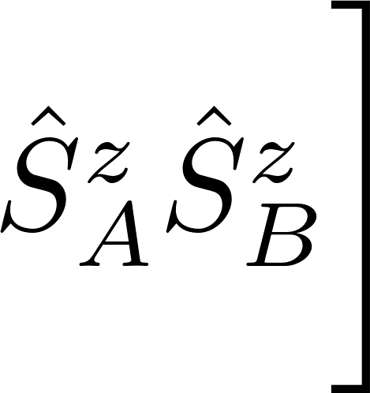

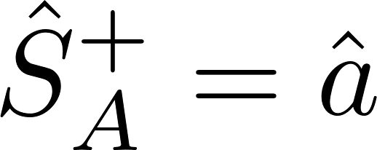
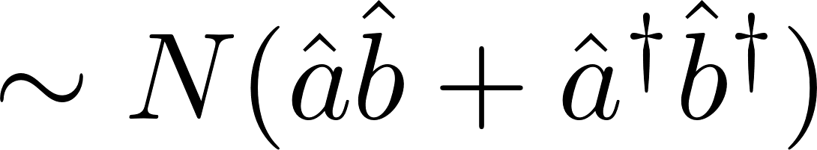
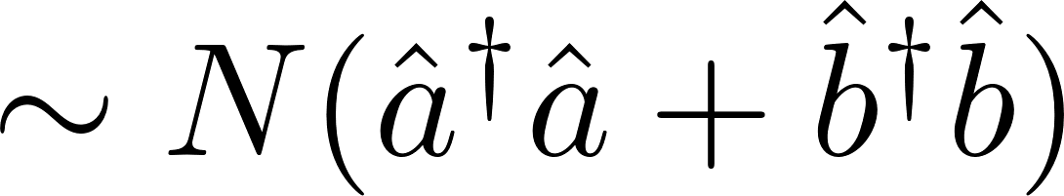
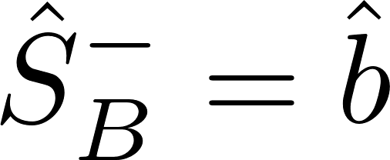
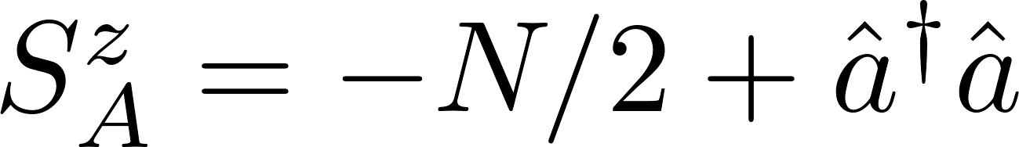

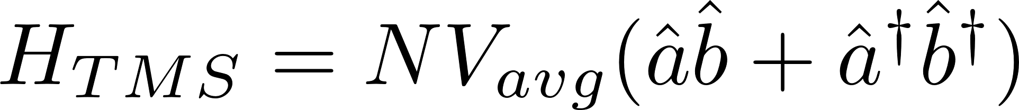
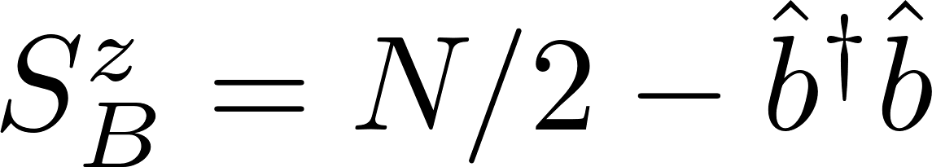

From power-law interaction to two-mode squeezing
Interlayer interaction:
Holstein-Primakoff
Spin exchange
Ising
Creates entangled pairs of excitation
via two-mode squeezing [1,2]:
Creates detuning
[1]Sundar, Bhuvanesh, et al., Physical Review Letters 130.11 (2023): 113202.
[2] Bilitewski, Thomas, and Ana Maria Rey. Physical Review Letters 131.5 (2023): 053001.
6
06/06/2024, DAMOP Meeting Arman Duha Oklahoma State University

Slide 7
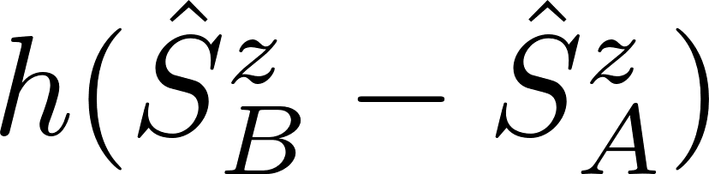
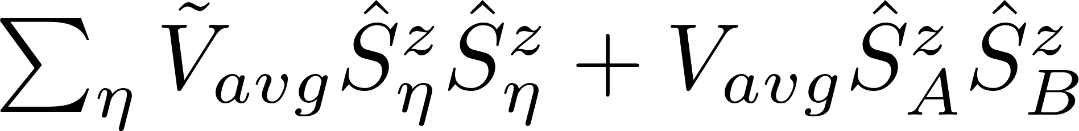
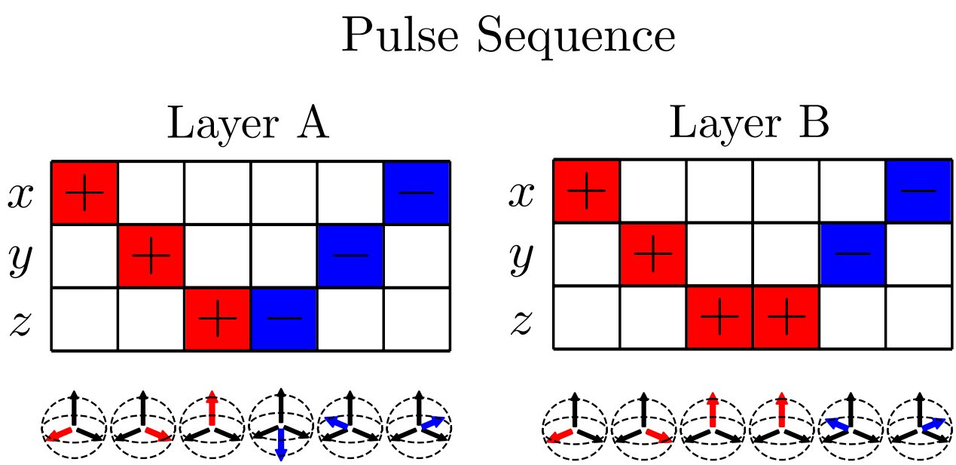
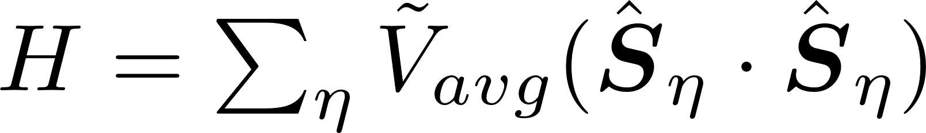
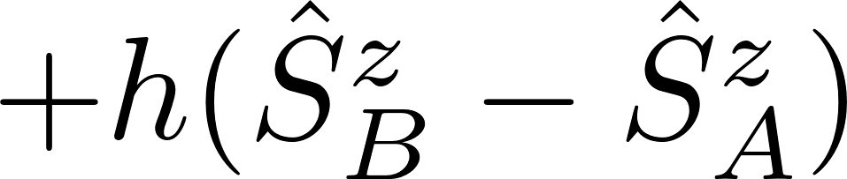
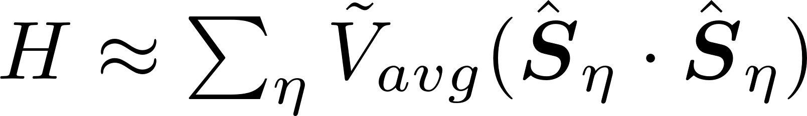
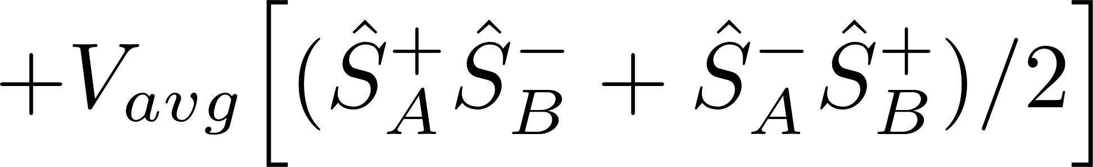

Staggered field Vs. Floquet – Pulse – Engineering [1]
Cancelling the detuning via
Staggered field:
Ising Hamiltonian:
7
[1] J. Choi et. Al., Phys. Rev. X 10, 031002 (2020)
06/06/2024, DAMOP Meeting Arman Duha Oklahoma State University

Slide 8
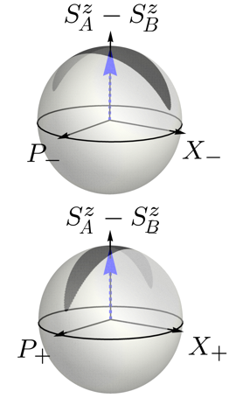
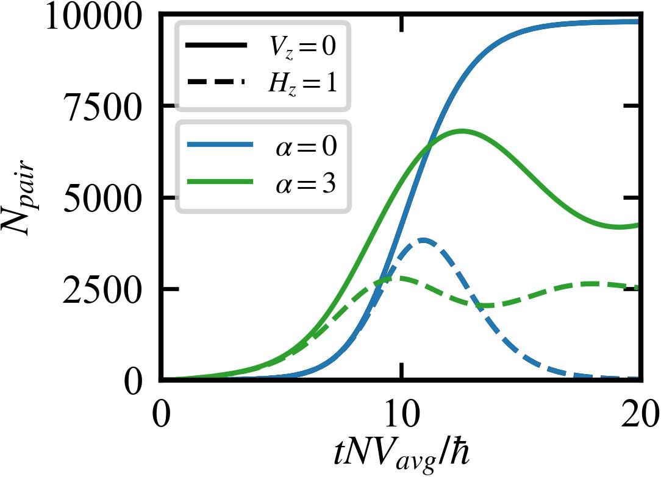
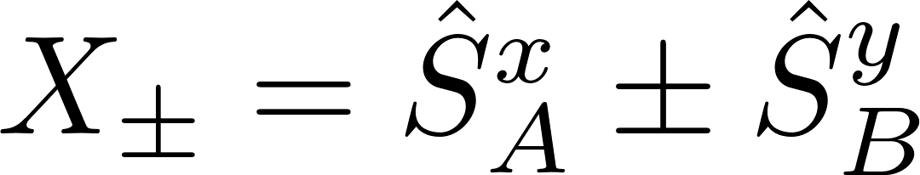
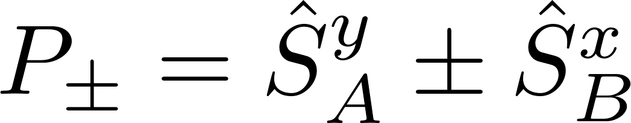
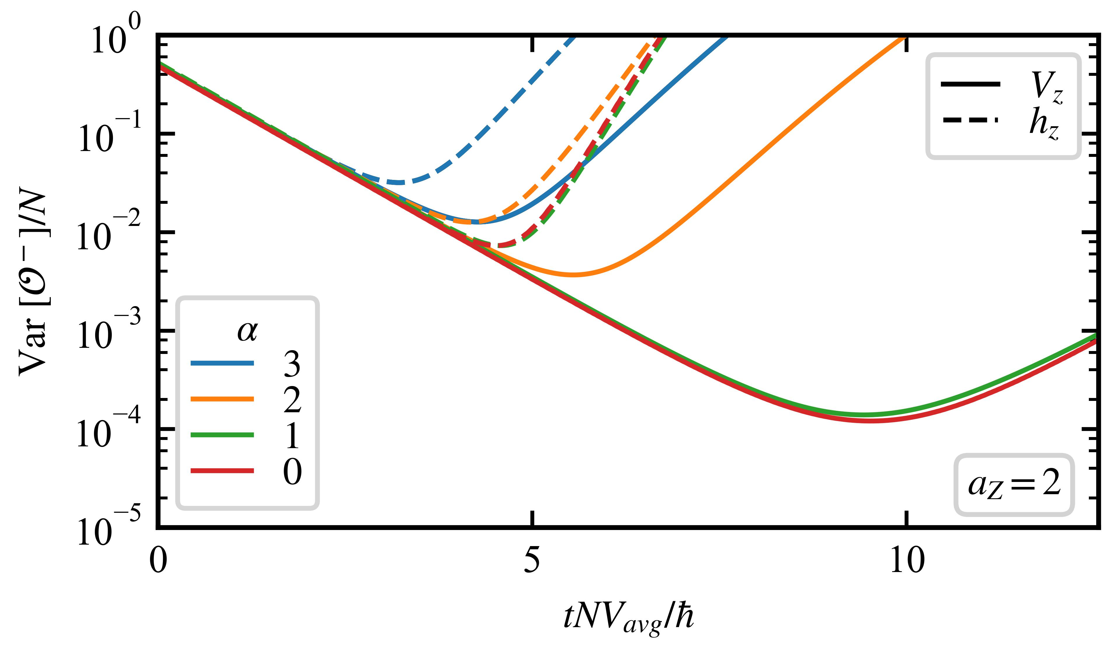
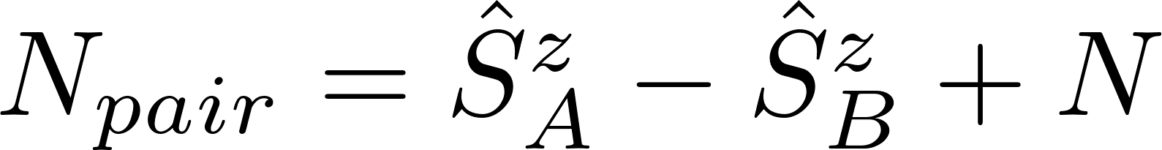
Enhanced Pair Production and Squeezing
Mixed Quadratures:
Orders of magnitude higher
achievable squeezing!
8
06/06/2024, DAMOP Meeting Arman Duha Oklahoma State University

Slide 9
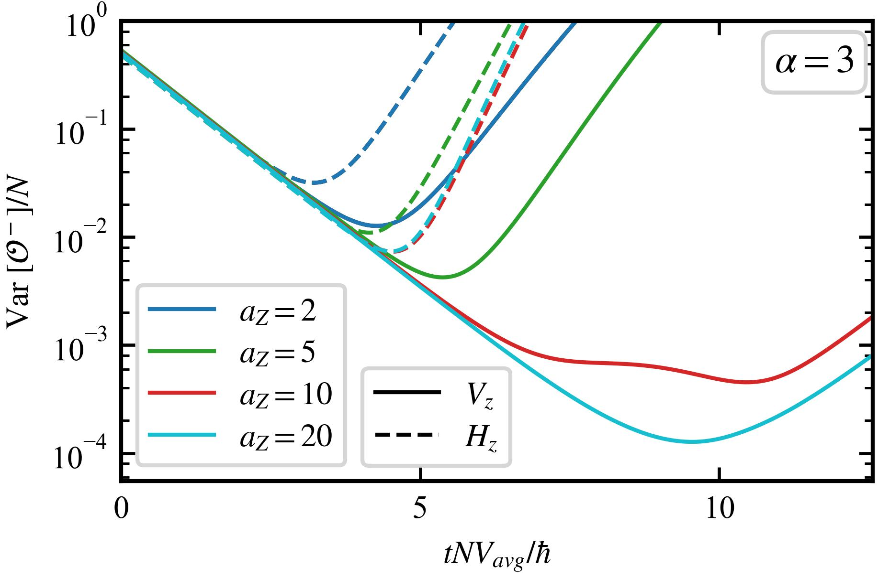
Achieving infinite range limit
Layer separation (a_{Z}) tuning protects collectiveness
Finite range (α=3) interaction achieves infinite range (α=0) limit squeezing
9
06/06/2024, DAMOP Meeting Arman Duha Oklahoma State University

Slide 10
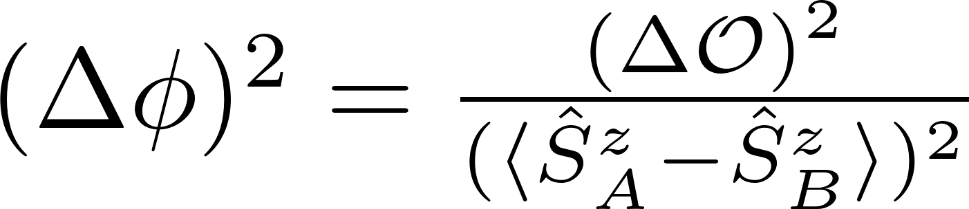
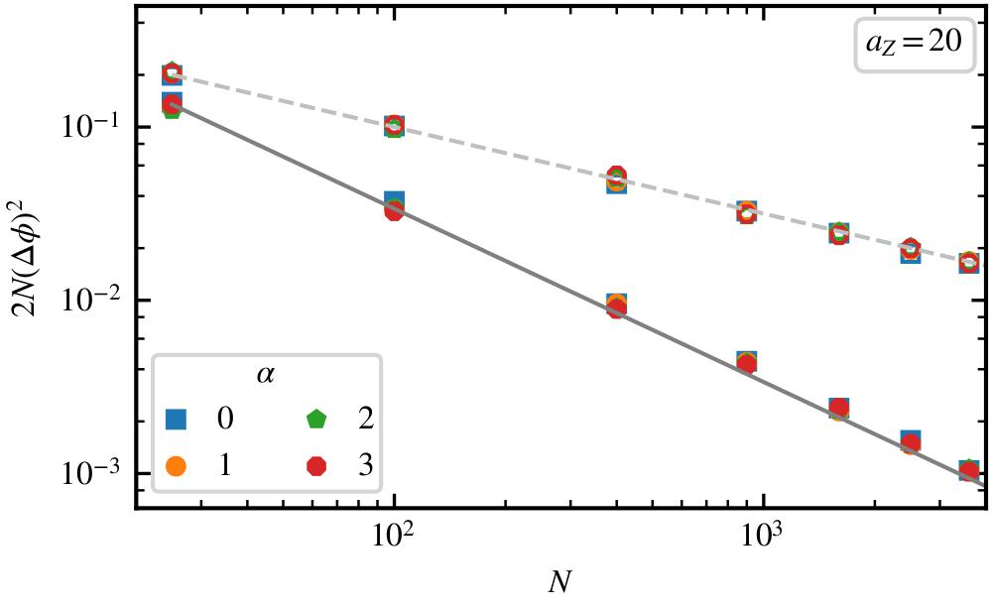
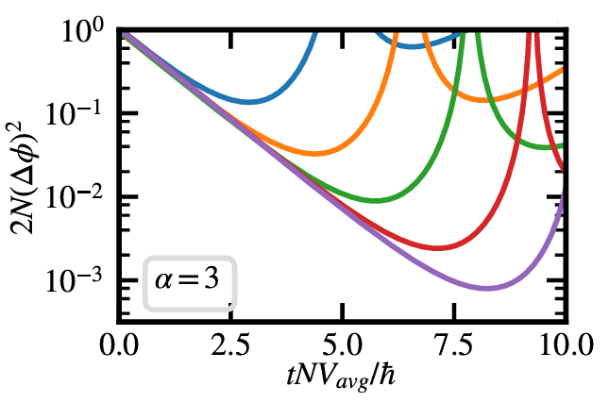
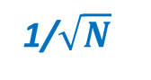
Optimal Heisenberg limited Scaling
1/$\sqrt{N}$
N = 5²
10²
20²
1/N
40²
70²
Floquet-engineered model achieves the
optimal Heisenberg limit of 1/N scaling!
10
06/06/2024, DAMOP Meeting Arman Duha Oklahoma State University

Slide 11
Outlook
Using spatio-temporal control Heisenberg limited scaling (1/N) of squeezing is achieved with finite range interactions
Orders of magnitude increase in achievable squeezing
Applicable for finite range, Ising interacting systems making our model realizable in a large variety of platforms:
Polar molecules (α=3)
Rydberg atoms(α=3,6)
Magnetic atoms (α=3)
Trapped ions (1< α<3)
11
06/06/2024, DAMOP Meeting Arman Duha Oklahoma State University

Slide 12
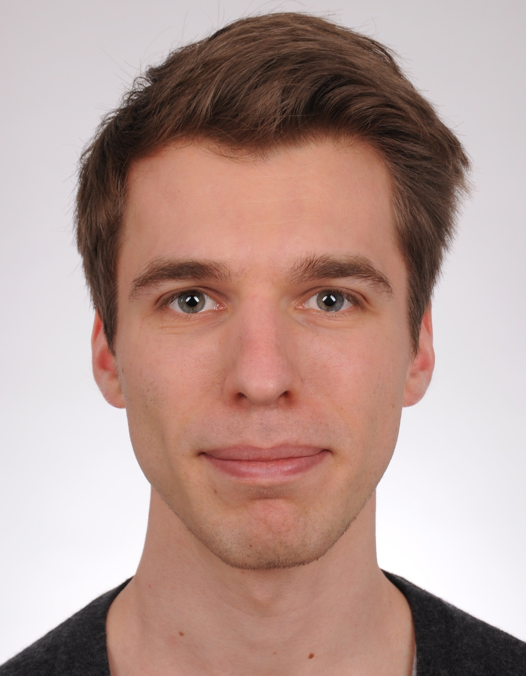
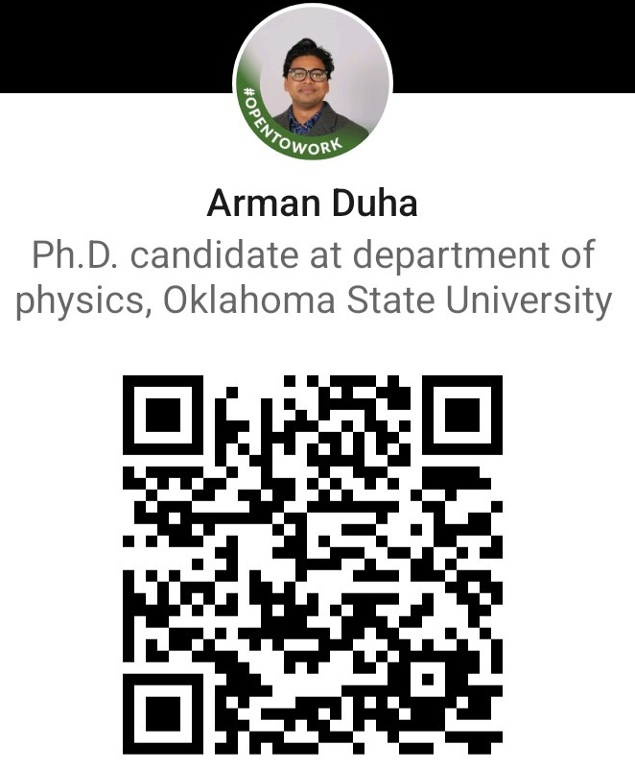

Acknowledgement
Collaborator:
Dr. Thomas Bilitewski
Oklahoma State University, Stillwater
Reference:
Two-mode squeezing in Floquet engineered
power-law interacting spin models
arXiv:2402.18642
Thank you for your attention!
Questions?
12
03/06/2024, APS March Meeting Arman Duha Oklahoma State University

Slide 13
Back-up slides

Slide 14
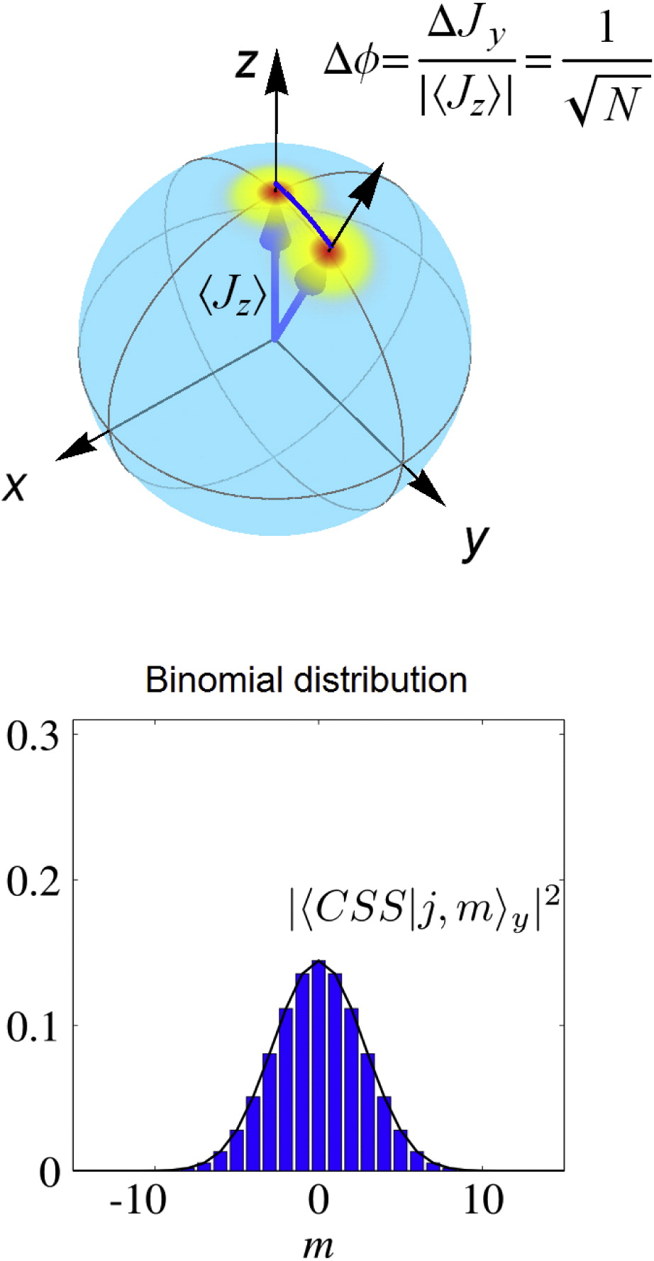
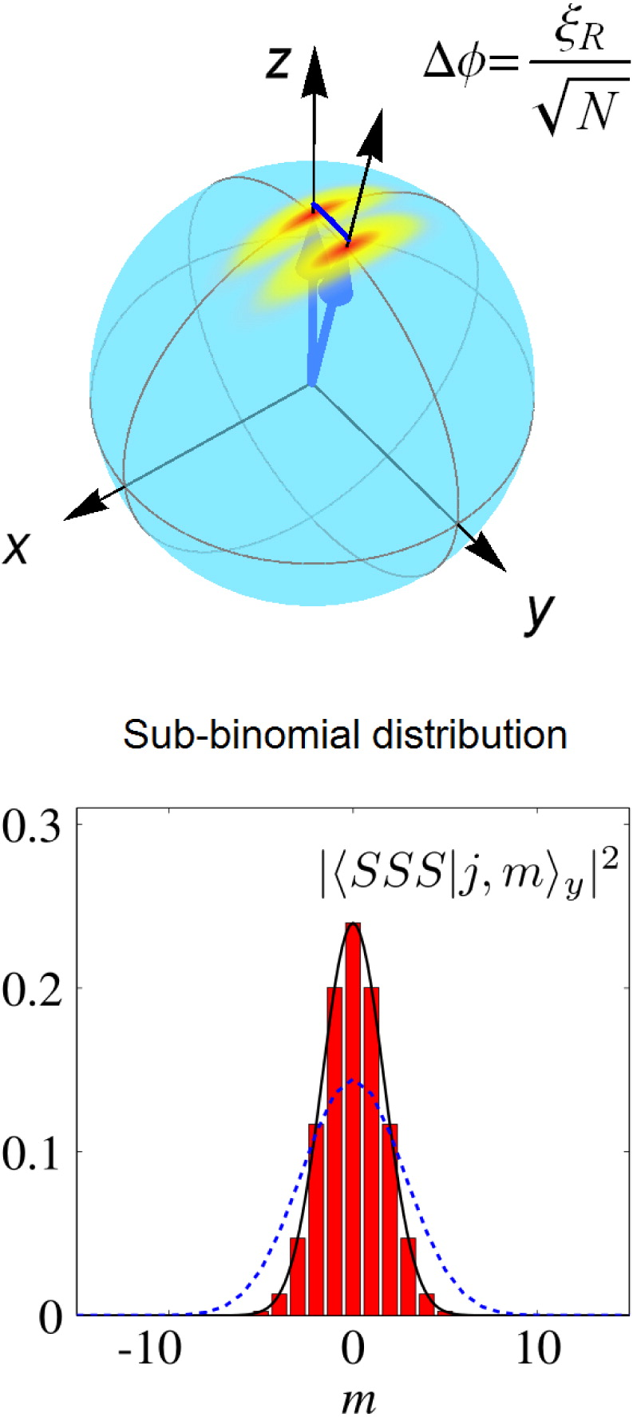
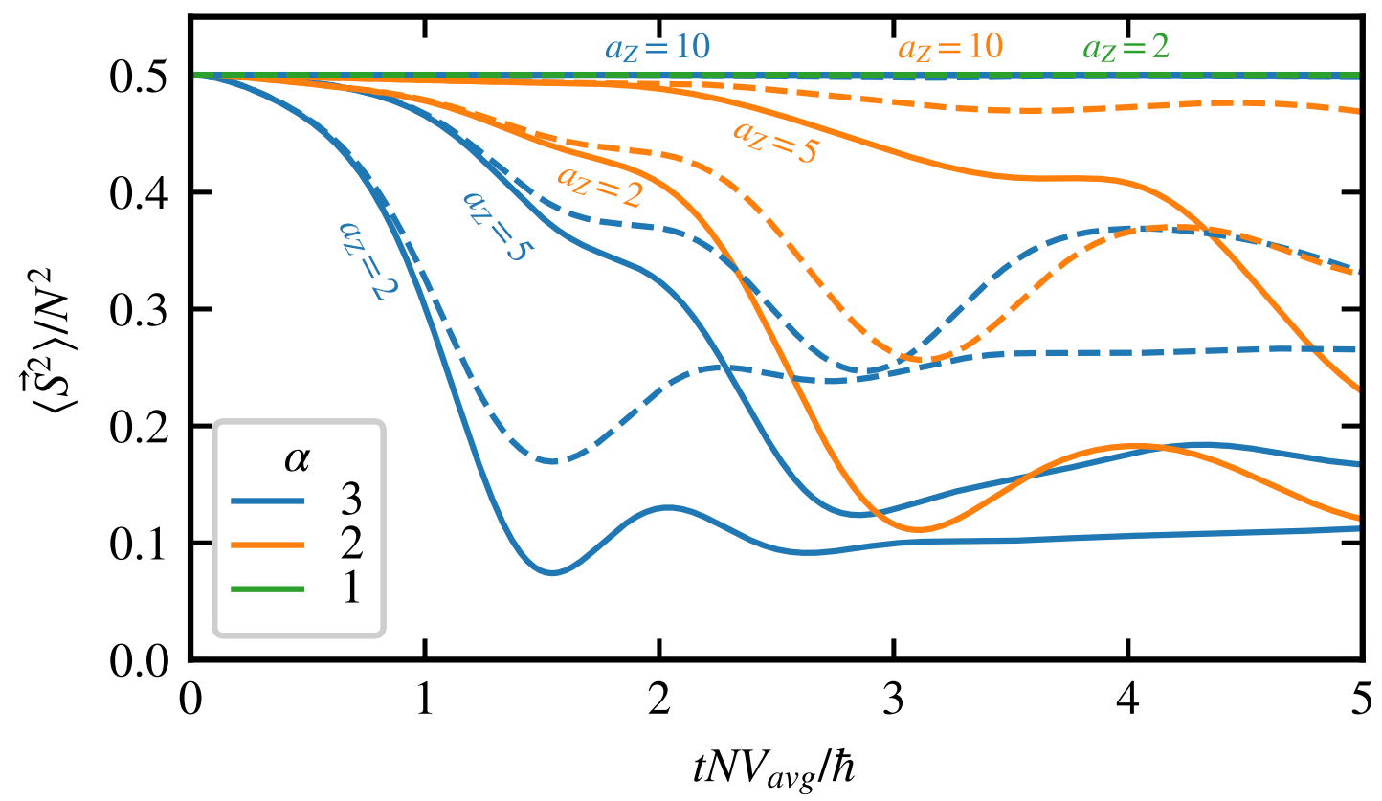
Ma, Jian, et al. “Quantum spin squeezing.”
Physics Reports 509.2-3 (2011): 89-165.

Slide 15
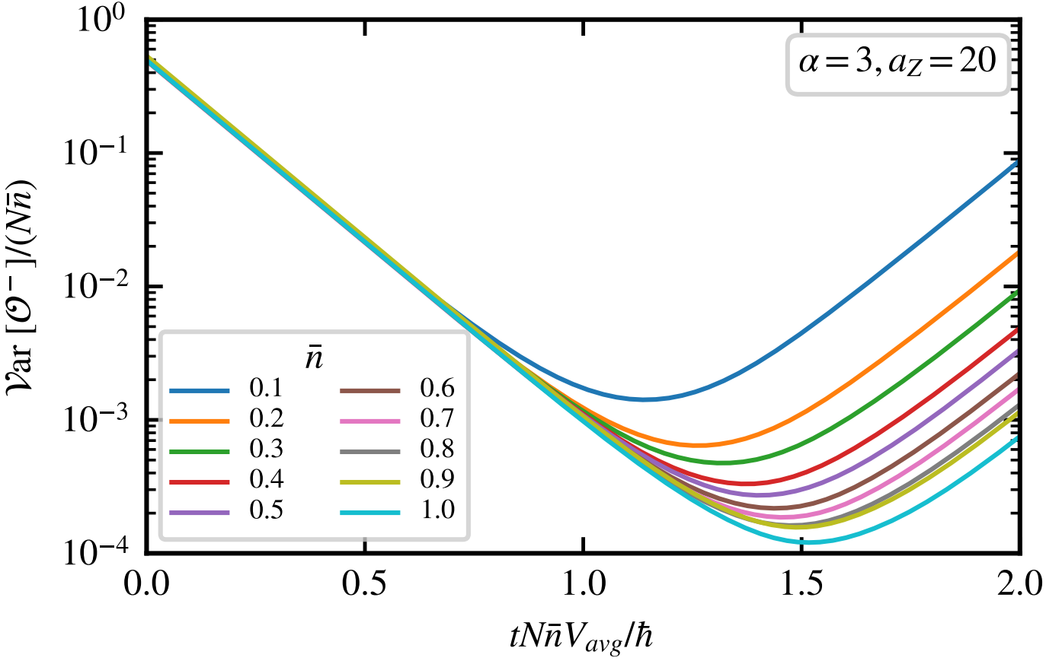

Slide 16



